Slide 1

Financial Time Series Prediction
David Ocepek

Slide 2
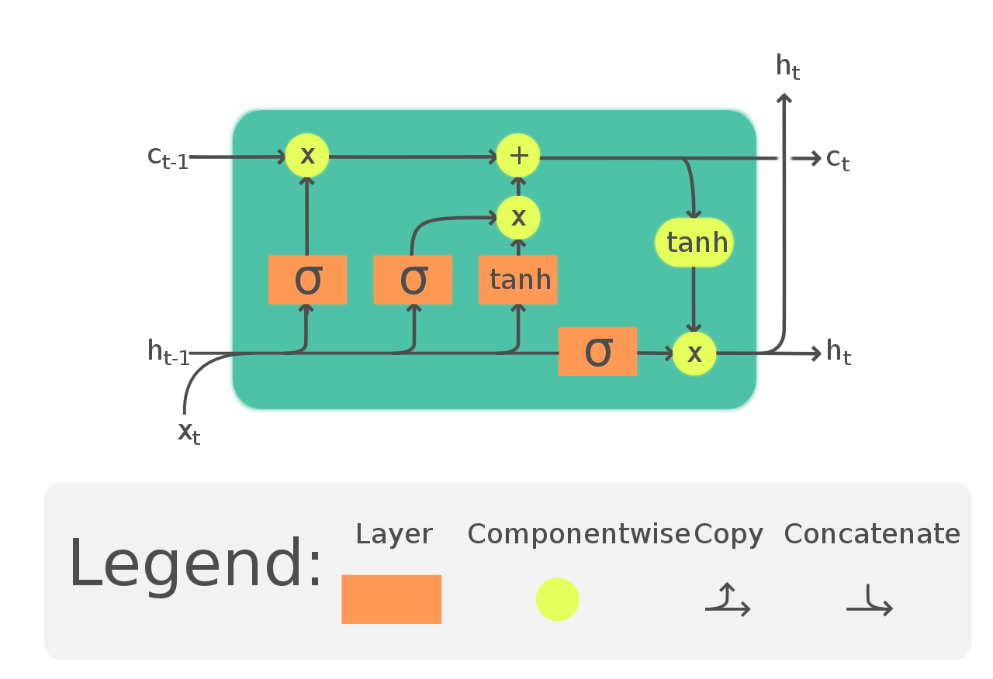


Models Used
Stateless LSTM-ANN (1D and 2D)
CNN-ANN
LSTM-CNN
ARIMA(baseline)

Slide 3
Specifications
Applied Approaches
TODO
Scaling
Standard
MinMax
Early Stopping+Model Checkpointing
Dropout
BatchNormalization
L1 & L2 Regression (Very small weight)
10-Fold Validation
Evaluation Metric: RMSE + MAPE
SSA/Vawelet Transform (smoothing)
Imputation of Missing Values (possibly can be fixed by SSA directly)

Slide 4
Intermediary results
Company | RMSE |  | MAPE
 | ARIMA | LSTM | ARIMA | LSTM
AAPL | 0.76 | 0.60 | 0.0104 | 0.0086
AMZN | 37.09 | 45.00 | 0.0135 | 0.0191
FB | 4.07 | 4.56 | 0.0134 | 0.0167
GOOG | 17.80 | 15.44 | 0.0107 | 0.0105
MSFT | 1.50 | 1.70 | 0.0094 | 0.0126

Slide 5
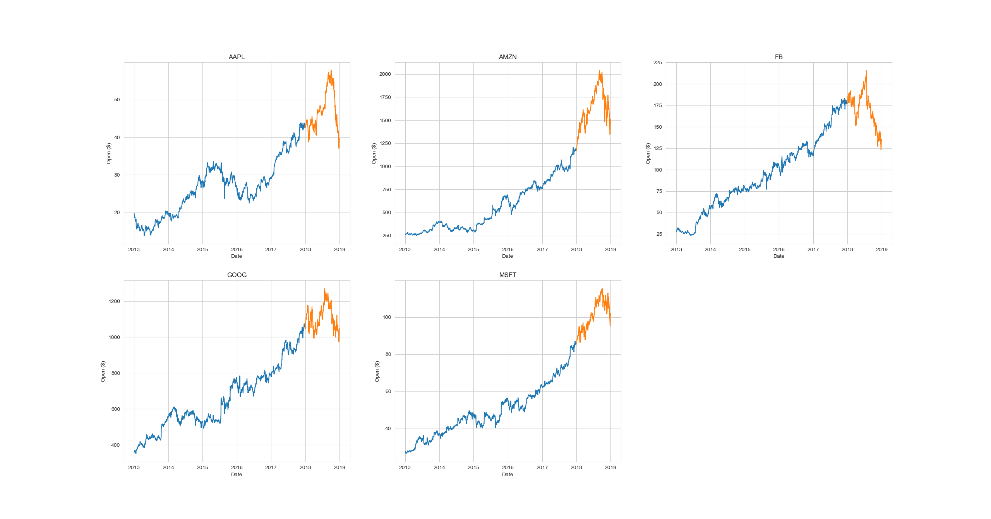
Datasets Used
Apple, Amazon, Google, Microsoft, Facebook
Train: 1.1.2013 – 1.1.2018
Test: 3.1.2018 – 1.1.2019
Source: Yahoo! Finance

Slide 6
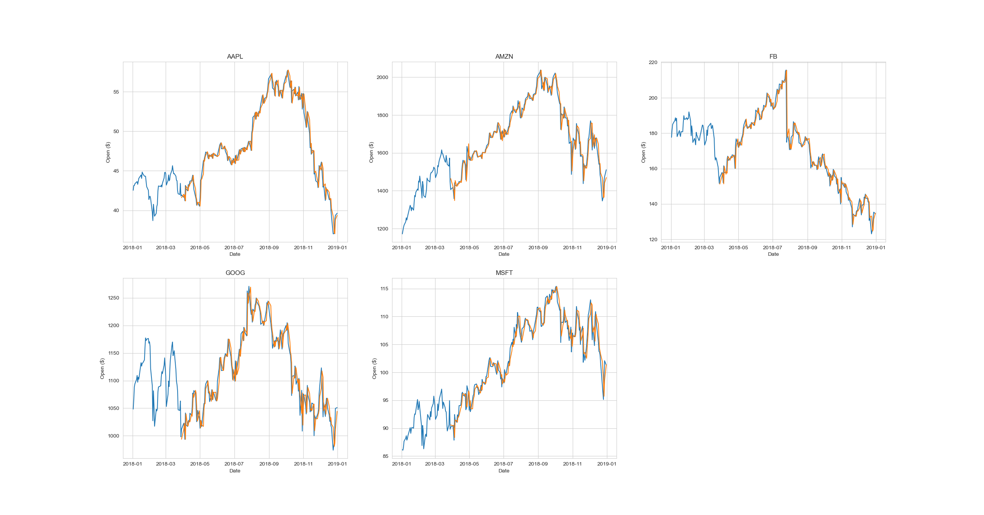
ARIMA

Slide 7
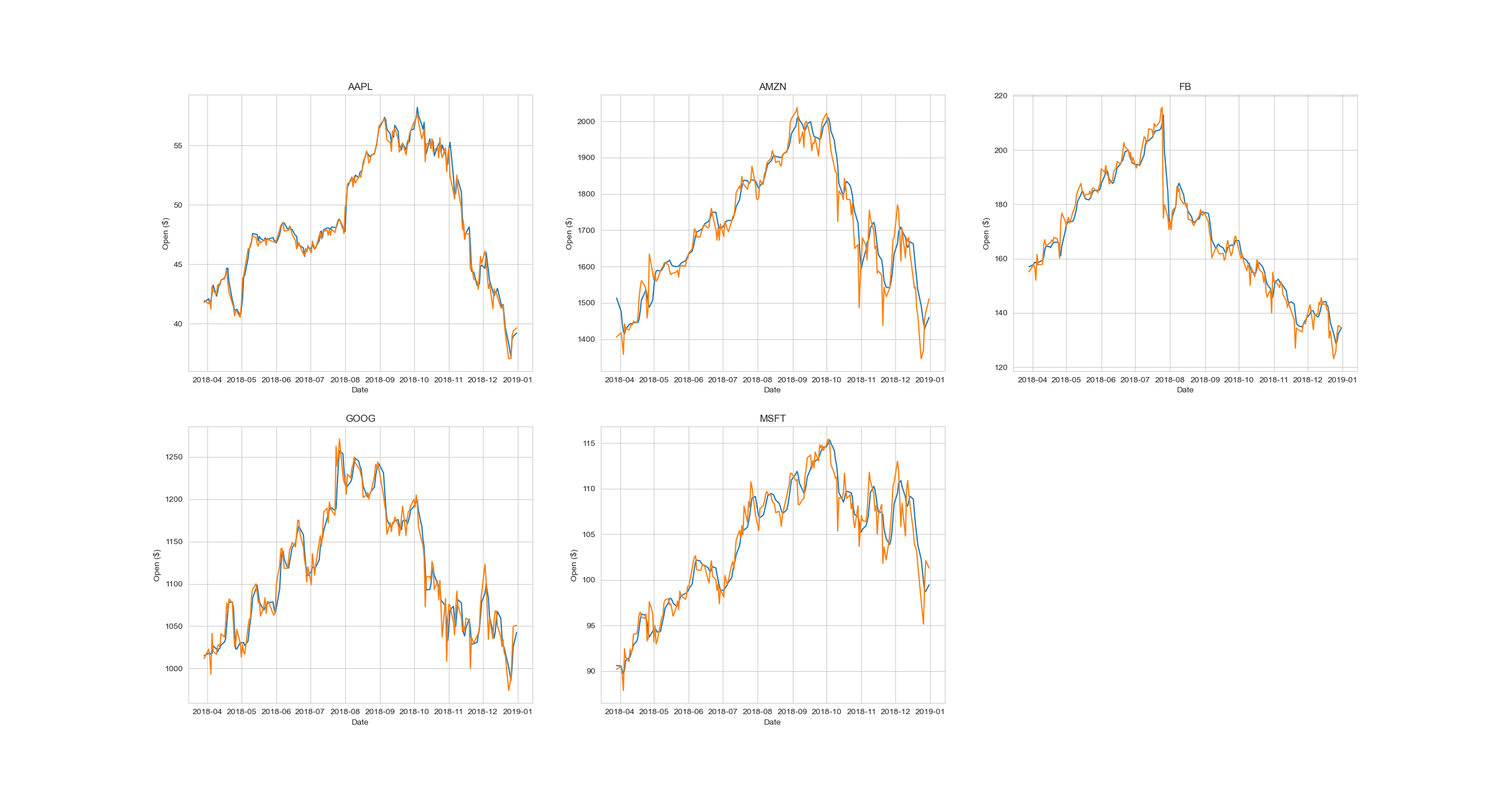
STACKED LSTM-ANN

Slide 8
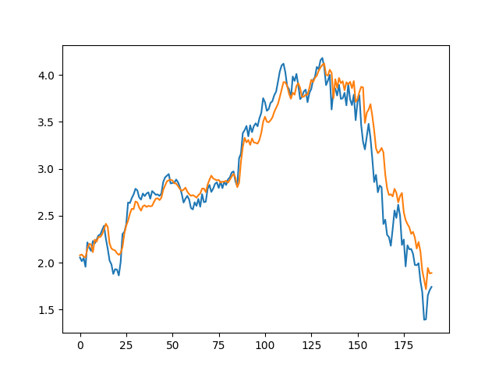
CNN + CNN-LSTM
CNN
CNN-LSTM

Slide 9
Literature
Lei Ji, Yingchao Zou, Kaijian He, Bangzhu Zhu, Carbon futures price forecasting based with ARIMA-CNN-LSTM model, Procedia Computer Science, Volume 162, 2019, Pages 33-38, ISSN 1877-0509, https://doi.org/10.1016/j.procs.2019.11.254. (https://www.sciencedirect.com/science/article/pii/S1877050919319660)
Chen, JieAU - Tang, QiAU - Shi, RuchenAU - Fan, TongmeiAU - Ma, YidanAU - Huang, JingyanPY - 2021DA - 2021/06/09TI - Prediction of Financial Time Series Based on LSTM Using Wavelet Transform and Singular Spectrum Analysis, https://doi.org/10.1155/2021/9942410
Ehsan Hoseinzade, Saman Haratizadeh, CNNpred: CNN-based stock market prediction using a diverse set of variables, Expert Systems with Applications, Volume 129, 2019, Pages 273-285, ISSN 0957-4174, https://doi.org/10.1016/j.eswa.2019.03.029. (https://www.sciencedirect.com/science/article/pii/S0957417419301915)
S. Selvin, R. Vinayakumar, E. A. Gopalakrishnan, V. K. Menon and K. P. Soman, "Stock price prediction using LSTM, RNN and CNN-sliding window model," 2017 International Conference on Advances in Computing, Communications and Informatics (ICACCI), 2017, pp. 1643-1647, doi: 10.1109/ICACCI.2017.8126078.

